Slide 1
Boolean Algebra

Slide 2
Index
Boolean Variable and Functions
Sum-of-Products and Product-of-Sums Forms
Axioms and Theorems
Derivation of the POS form
Perfect Induction
Simplifying Equations
Schematic
Programmable Logic Array
Drawing rules
Multiple-output circuits
Multilevel Combinational Logic
Bubble Pushing
X and Z
Karnaugh maps
Logic Minimization
Seven-segment Display Decoder
Don’t Cares

Slide 3
Boolean Variable and Functions (1)
Let X be a certain discreet variable, we call boolean variable any discreet variable that can assume only two values:
X = 0 False
X = 1 True
If we have the boolean variables X₁, X₂, . . ., X_{n}
f (X1, X2, . . . , Xn)
is called a boolean function, and it can assume only the values 0 and 1
associates a boolean value to every element in its domain
The domain of a function of n-variables is composed of all the 2^{n} combinations of their values
domain’s elements are countable
Two functions are equivalent if they assume the same value for any combination of their variables’ values

Slide 4
Boolean Variable and Functions (2)
The complement of a variable A is its inverse A
we call A the true form of the variable
and A the complementary form
Literals are the number of element that make up a boolean expression (not to be confused with the number of variables)
f (a, b) is a logical function with two binary variables a and b
f = a + b has 2 literals
f = ab + ab has 4 literals
The AND of one or more literals is called implicant (or product)
AB, ABC, and B are all implicants
A minterm is an implicant involving all of the inputs to the function
ABC is a minterm for a function of the three variables A, B, and C
The OR of one or more literals is called a sum
A maxterm is a sum involving all of the inputs to the function
A + B + C is a maxterm for a function of the three variables A, B, and C

Slide 5
Boolean Variable and Functions (3)
The order of operations is important when interpreting equations
NOT has the highest precedence
followed by AND, then OR (just as in ordinary equations)
Y = A + BC means Y = A OR (B AND C)

Slide 6
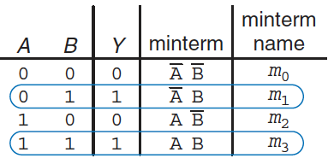
Sum-of-Products Form (1)
A truth table of N inputs contains 2^{N} rows
one for each possible value of the inputs
We can associate each row with a minterm that is TRUE for that row
Example of two inputs:
the minterm for the first row is A B because it is TRUE when A=0, B=0
The minterms are numbered starting with 0 (m₀, m₁, m₂, and so on)
We can write the boolean equation by summing each of the minterms for which the output is TRUE
in the example, there are two rows (or minterm) for which the output is TRUE
thus, Y = A B + A B
This is called the sum-of-products (SOP) canonical form of a function, because it is the sum (OR) of products (AND). In sigma notation:
f(A,B) = 𝛴(m₁, m₃)

Slide 7
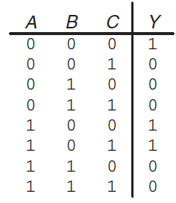
Sum-of-Products Form (2)
The sum-of-products form provides a boolean equation for any truth table with any number of variables:
Y = A B C + A B C + A B C = 𝛴(m₀,m₄,m₅)
Unfortunately, sum-of-products form does not necessarily generate the simplest equation
m₀: A B C
m₁: A B C
m₂: A B C
m₃: A B C
m₄: A B C
m₅: A B C
m₆: A B C
m₇: A B C

Slide 8
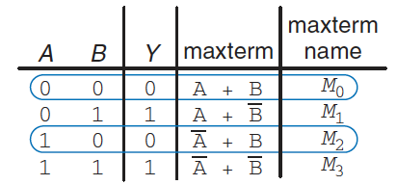
Product-of-Sums Form (3)
An alternative way of expressing boolean functions
We can associate each row of a truth table with a maxterm that is FALSE for that row
Example of a two input:
the maxterm for the first row is (A + B) it is FALSE when A=0, B=0
We can write the boolean equation as the AND of each of the maxterms for which the output is FALSE
in the example, there are two maxterm for which the output Y is FALSE
thus, Y = (A+B) (A+B)
This is called the product-of-sum (POS) canonical form of a function. In pi notation: f(A,B) = π(M₀, M₂)
SOP produces a shorter equation when the output is TRUE on only a few; POS is simpler when the output is FALSE on only a few rows

Slide 9
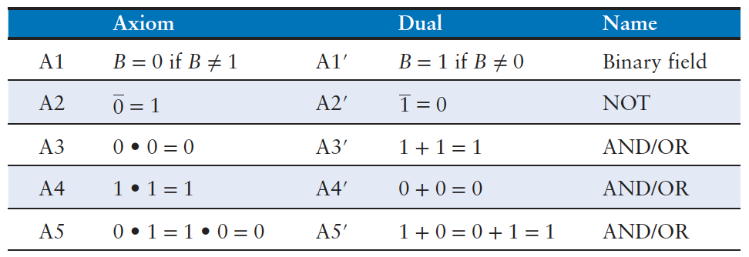
Axioms
We learned how to write a boolean expression given a truth table
that expression does not necessarily lead to the simplest set of logic gates
We can use boolean algebra to simplify boolean equations
rules are much like those of ordinary algebra
In some cases simpler because variables have only two possible values: 0 or 1
Based on a set of axioms that we assume are correct
five axioms define boolean variables and the meanings of NOT, AND, and OR
principle of duality: if the symbols 0 and 1 and the operators • (AND) and + (OR) are interchanged, the statement will still be correct.

Slide 10
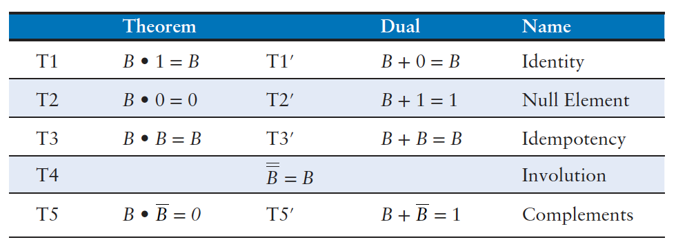


Theorems of One Variable (1)
Describe how to simplify equations involving one variable:
T1 Identity theorem
if one input of a two-input AND gate is always 1, we can remove the AND gate and replace it with a wire connected to the variable input
if one input of a two-input OR gate is always 0, we can replace the OR gate with a wire connected to B
In general, gates cost money, power, and delay, so replacing it with a wire is beneficial!

Slide 11





Theorems of One Variable (2)
T2 Null element theorem
B AND 0 is always equal to 0 (null element for the AND operation because it nullifies the effect of any other input)
if one input of an AND is 0, we can replace the AND with a wire that is tied LOW
B OR 1 is always equal to 1 (null element for the OR operation)
if one input of an OR is 1, we can replace the OR with a wire that is tied HIGH
T3 Idempotency theorem
a variable AND/OR itself is equal to just itself
idem (same) and potent (power)
permits replacing a gate with a wire
T4 Involution theorem
complementing a variable twice results in the original variable
two inverters in series logically cancel each other out and are logically equivalent to a wire

Slide 12


Theorems of One Variable (3)
T5 Complement theorem
a variable AND its complement is 0
because one of them has to be 0
a variable OR its complement is 1
because one of them has to be 1

Slide 13
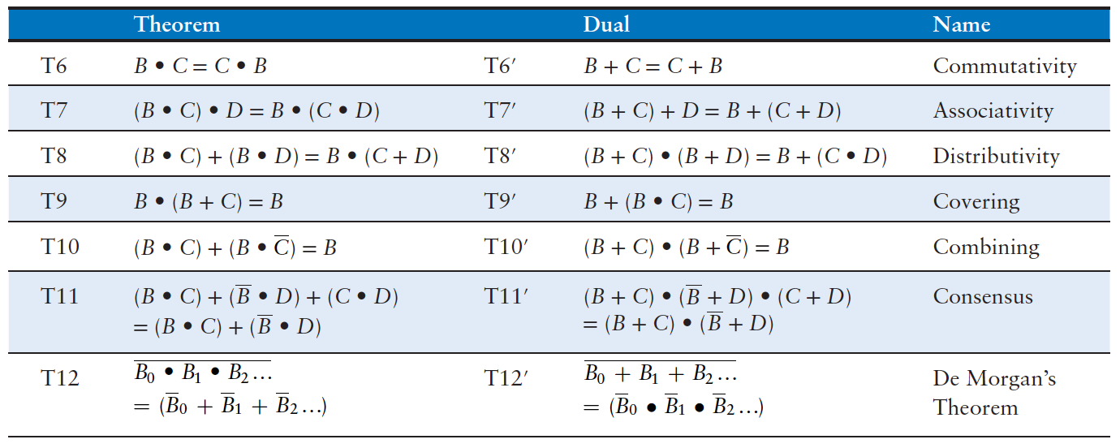
Theorems of Several Variables (1)
Describe how to simplify equations involving more than one variable:
T6 Commutativity and T7 Associativity theorems
work the same as in traditional algebra
the order of inputs does not affect the value of the output
specific groupings of inputs do not affect the value of the output

Slide 14
Theorems of Several Variables (2)
T8 Distributivity theorem
AND distributes over OR and OR distributes over AND
different from traditional algebra
multiplication distributes over addition
but addition does not distribute over multiplication ( (B + C) × (B + D) ≠ B + (C × D)
T9 Covering, T10 Combining, and T11 Consensus theorems
permit us to eliminate redundant variables
prove true using other axioms and theorems:
B•(B+C) = B•B + B•C = (T8 Distributivity) = B + B•C = (T3 Idempotency) = B•(1 + C) = (T8 Distributivity) = B•(1) = (T2 Null element) = B (T1 Identity)
B•C + B•C = B•(C+C) = (T8 Distributivity) = B•(1) = (T5’ Complements) = B (T1 Identity)

Slide 15
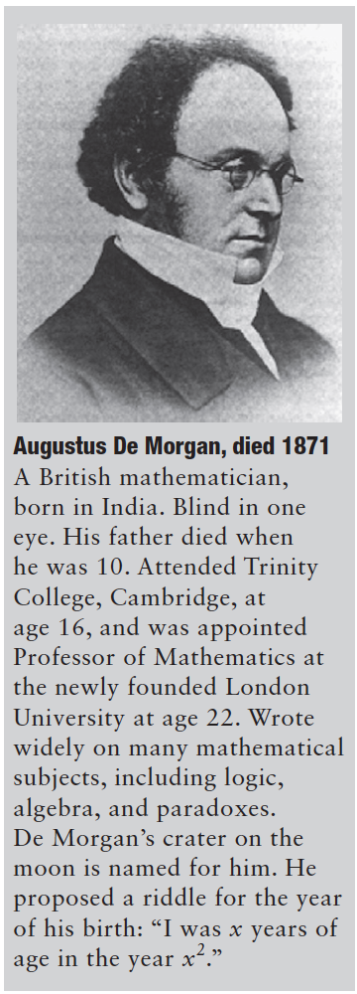
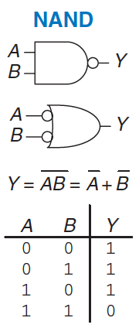
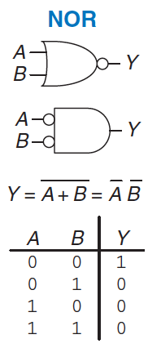
T12 De Morgan’s Theorem
The complement of the product of all the terms is equal to the sum of the complement of each term
a NAND gate is equivalent to an OR gate with inverted inputs
The complement of the sum of all the terms is equal to the product of the complement of each term
a NOR gate is equivalent to an AND gate with inverted inputs
The inversion circle is called a bubble
intuitively, we can imagine that “pushing” a bubble through the gate causes it to come out at the other side and flips the body of the gate from AND to OR or vice versa

Slide 16
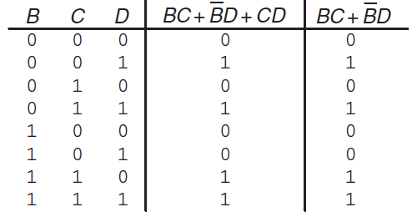
Perfect induction
Proof of theorems with a finite number of variables are easy
just show that the theorem holds for all possible values of these variables
Example: proving the T11 Consensus theorem using perfect induction:
check both sides of the equation (BC + BD + CD = BC + BD) for all eight combinations of B, C, and D
Because BC + BD + CD = BC + BD for all cases, the theorem is proved!

Slide 17
Simplifying Equations (1)
Theorems help us simplify boolean equations
example, consider the previously sum-of-products expression Y = AB + AB
by using the T10 Combining theorem the equation simplifies to Y = B
this may have been obvious looking at the truth table
in general, multiple steps may be necessary to simplify more complex equations
The basic principle of simplifying sum-of-products equations is to combine terms using the relationship PA + PA = P, where P may be any term
How far can an equation be simplified?
we define an equation in sum-of-products form to be minimized if it uses the fewest possible implicants
if there are several equations with the same number of implicants, the minimal one is the one with the fewest literals
An implicant is called a prime implicant if it cannot be combined with any other implicants in the equation to form a new implicant with fewer literals
implicants in a minimal equation must all be prime implicants
otherwise, they could be combined to reduce the number of literals

Slide 18
Simplifying Equations (2)
Minimize A B C + A B C + A B C
Minterms A B C and A B C differ only in A, so we can combine them to form B C
B C + A B C
Notice that also minterms A B C and A B C differ by a single literal, thus we could have combined these two
A B C + A B
Implicants B C and A B share the minterm A B C
So, are we stuck with simplifying only one of them?
Using the idempotency theorem, we can duplicate terms as many times
T3 Idempotency: A B C + A B C + A B C +A B C
T8 Distributivity: B C (A + A) + A B (C + C)
T5 Complements: B C (1) + A B (1)
T1 Identity: B C + A B

Slide 19
Simplifying Equations (1)
Why bother simplifying a Boolean equation if it remains logically equivalent?
reduction of the number of gates
make the circuit smaller, cheaper, and possibly faster
Notice that simplifying boolean equations with theorems can take some trial and error, later we describes a methodical technique (Karnaugh maps) that makes the process easier

Slide 20



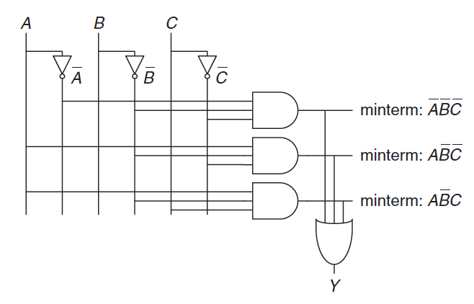
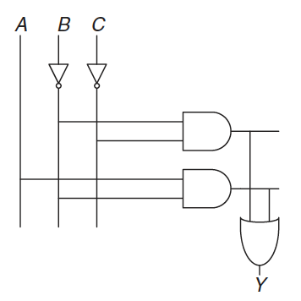
Schematic
A schematic is a diagram of a digital circuit showing the elements and the wires that connect them
Notice that the simplified circuit has significantly less hardware than that of the original equation, it may be faster because it uses gates with fewer inputs

Slide 21
Programmable Logic Array
Any Boolean equation in sum-of-products form can be drawn in a systematic way:
draw columns for the inputs
place inverters in adjacent columns
draw rows of AND gates for each of the minterms
for each output, draw an OR gate connected to the related minterms
This style is called a Programmable Logic Array (PLA) because the inverters, AND gates, and OR gates are arrayed in a systematic fashion

Slide 22
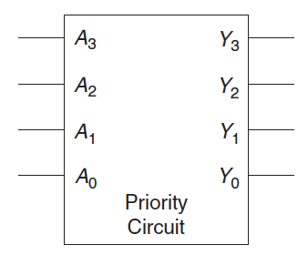
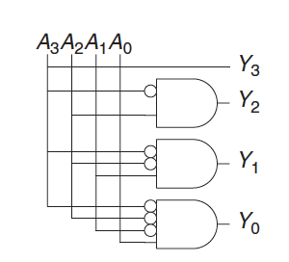
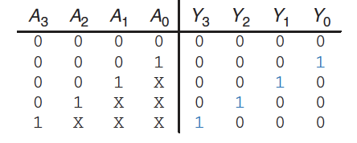
Multiple-output Circuits
Many circuits have multiple outputs
each computes a separate boolean function of the inputs
we can write a separate truth table for each output
or write all of the outputs on a single truth table
Example: priority circuit
we can use sum-of-products form and reduce the equations using boolean algebra
however, the simplified equations are clear by inspection
notice that if A₃ is 1, the outputs don’t care what the other inputs are: we use the symbol X
Experienced designer often implement a logic circuit by inspection

Slide 23
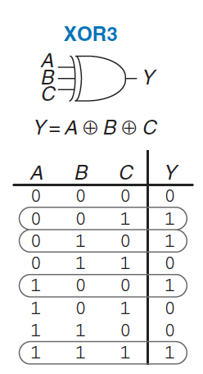
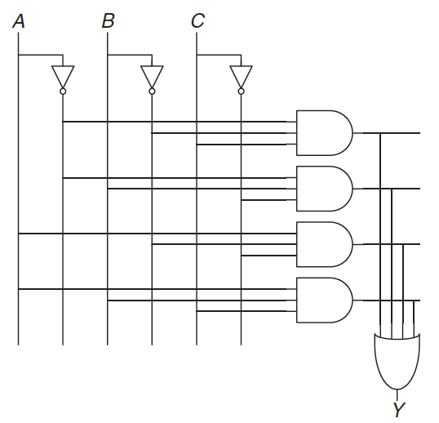

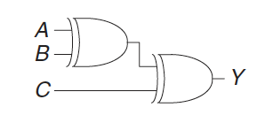

Multilevel Combinational Logic (1)
Logic in sum-of-products form is called two-level logic
it consists of literals connected to a level of AND gates connected to a level of OR gates
some logic functions require an enormous amount of hardware
Example: the XOR function of multiple variables
consider building a three-input XOR using the two-level techniques
an N-input XOR produces a TRUE output when an odd number of inputs are TRUE
On the other hand, notice that:

Slide 24
Multilevel Combinational Logic (2)
Designers often build circuits with more than two levels of logic gates
may use less hardware
However, selecting the best multilevel implementation of a specific logic function is not a simple process: “best” has many meanings
fewest gates, fastest, shortest design time, least cost, least power consumption, etc..
“best” circuit in one technology is not necessarily the best in another
e.g. CMOS circuits prefer NANDs and NORs over ANDs and ORs
With some experience, you will find that you can create a good multilevel design by inspection for most circuits
Computer-Aided Design (CAD) tools are also available to search a vast space of possible multilevel designs and seek the one that fits your constraints given the available building blocks

Slide 25
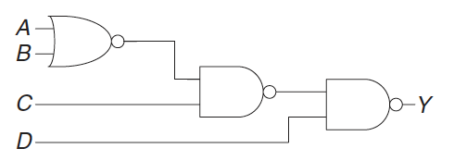
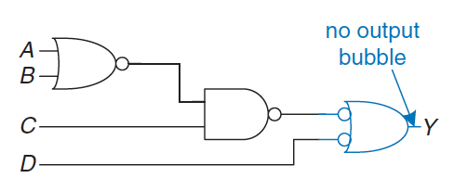
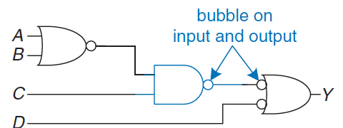
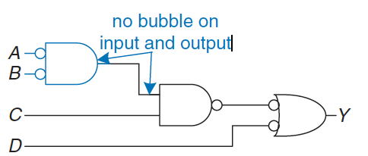
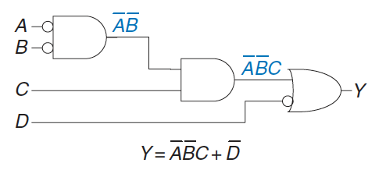
Bubble Pushing
Redraw circuits (with lots of NAND and NOR) so that the function can be more easily determined
Algorithm:
begin at the output of the circuit and work toward the inputs
push bubbles back toward the inputs
we can read the equation in terms of the output instead of its complement
working backward, draw each gate in a form so that bubbles cancel
If the current gate has an input bubble, draw the preceding gate with an output bubble
bubbles in series cancel

Slide 26
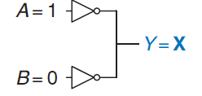
X and Z (1)
Boolean algebra is limited to 0 and 1, real circuits can also have illegal and floating values
X indicates that the circuit node has an unknown or illegal value
commonly happens if it is being driven to both 0 and 1 at the same time
this situation (contention) is considered to be an error and must be avoided
the actual voltage on a node with may be somewhere between 0 and VDD, depending on the relative strengths of the gates driving gates
X are also used by circuit simulator to indicate an uninitialized value
X can indicate “don’t care” values in truth tables
be sure not to mix up the two meanings

Slide 27
X and Z (2)
Z indicates that a node is being driven neither HIGH nor LOW
the node is said to be floating or high impedance
Typical misconception: a floating node is the same as a logic 0. No: a floating node might be 0, might be 1, or might be at some voltage in between
A common way to produce a floating node is to forget to connect a voltage to a circuit input
this may cause the circuit to behave erratically, as the floating input randomly changes from 0 to 1
touching the circuit may be enough to trigger the change by means of static electricity from the body
you can seen circuits that operate correctly only as long as the student keeps a finger pressed on a chip…

Slide 28
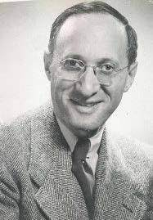
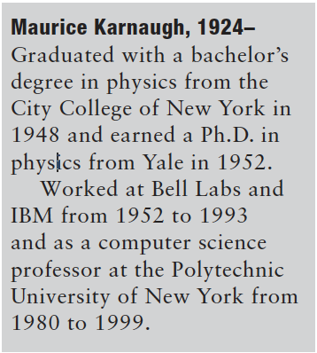
Karnaugh maps
K-maps are a graphical method for simplifying boolean equations
works well for problems with up to four variables
give insight into manipulating boolean equations
invented in 1953 by Maurice Karnaugh, a telecommunications engineer at Bell Labs
Recall that logic minimization involves combining terms
two terms containing an implicant P and the true and complementary forms of some variable A are combined to eliminate A:
PA + PA = P
Karnaugh maps make these combinable terms easy to see by putting them next to each other in a grid

Slide 29
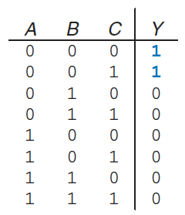
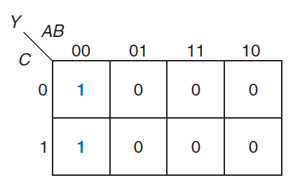
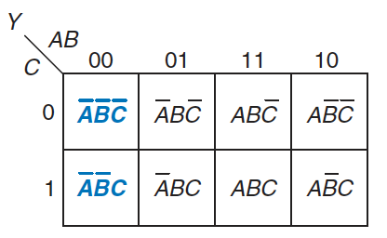
Constructing a Map (1)
Consider the truth table of a three-input function:
The K-map of that table is constructed as:
top row gives the four possible values for A and B
left column gives the two possible values for C
each square corresponds to a row in the truth table and contains the value of the output
a single minterm
For example:
top left square corresponds to the first row in the truth table Y 1 when ABC=000
the minterm is A B C

Slide 30
Constructing a Map (2)
Notice that, each square (minterm) differs from an adjacent square by a change in a single variable
adjacent squares share all the same literals except one
which appears in true form in one square and in complementary form in the other
squares representing the minterms A B C and A B C are adjacent and differ only in the variable C
In order to obtain this property, A and B combinations in the top row are in a peculiar order (Gray code)
00, 01, 11, 10
differs from ordinary binary order (00, 01, 10, 11) in that adjacent entries differ only in a single variable
The K-map also “wraps around”
squares on the far right are “adjacent” to the squares on the far left
they differ only in one variable (A)
we can roll the map into a cylinder form a torus

Slide 31
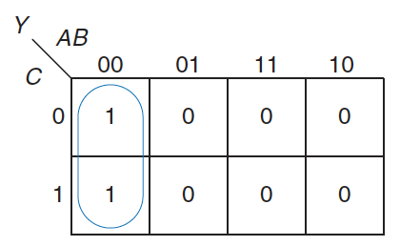
Constructing a Map (3)
We can use boolean algebra to minimize equations in sum-of-products form:
However, K-maps help us do this simplification graphically:
circle all the rectangular blocks of 1 in the map
each circle should be as large as possible
for each circle, write the corresponding implicant
variables whose true and complementary forms are both in the circle are excluded from the implicant
In the example:
C has both its true form and its complementary form (0) in the circle, so we do not include it in the implicant
Y is TRUE when A=B=0, independent of C
The K-map gives the same answer we reached using boolean algebra

Slide 32
Logic Minimization with K-Maps
More formally, recall that a boolean equation is minimized when it is written as a sum of the fewest number of prime implicants
each circle on the K-map represents an implicant
the largest possible circles are prime implicants
Rules for finding a minimized equation from a K-map are as follows:
all the squares in each circle must contain 1
use the fewest circles necessary to cover all the 1
each circle must span a rectangular block that is a power of 2 (i.e. 1, 2, or 4) squares in each direction
each circle should be as large as possible
a circle may wrap around the edges of the K-map
a 1 in a K-map may be circled multiple times if doing so allows fewer circles to be used

Slide 33
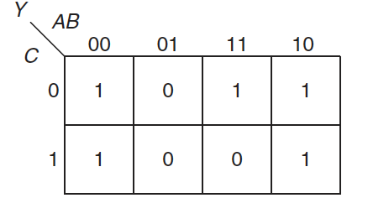
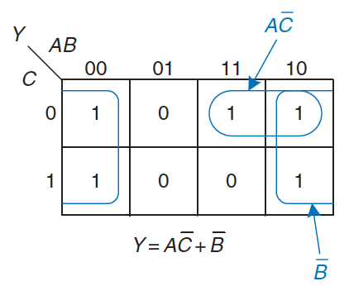
Example of minimization
Suppose we have the function Y = F(A, B, C) with the following K-map:
Minimize the equation:
circle the 1 using as few circles as possible
form the prime implicant by writing those variables that appear in the circle only in true or only in complementary form
Notice
the top-right square is covered twice to make the prime implicant circles as large as possible
the circle covering four squares wraps around the sides of the K-map

Slide 34
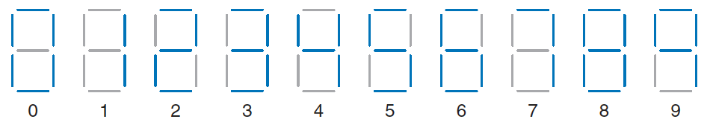
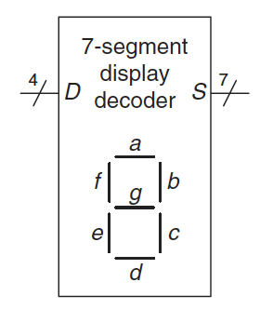
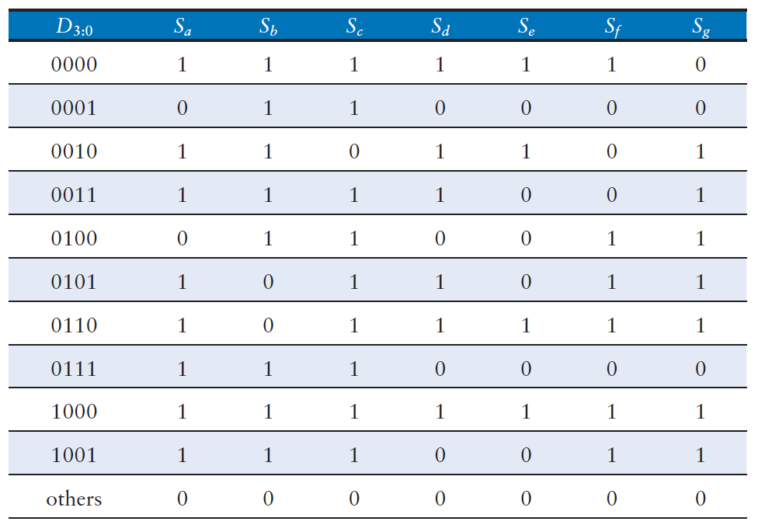
Seven-segment Display Decoder (1)
A device that takes a 4-bit data input D_{3:0} and produces seven outputs S_{a} - S_{g} to control a display from 0 to 9
The truth table is:

Slide 35
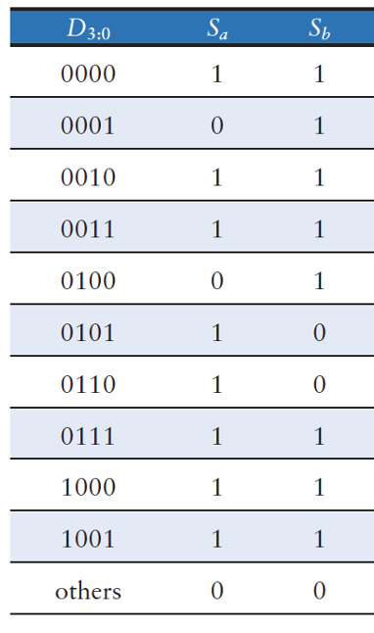
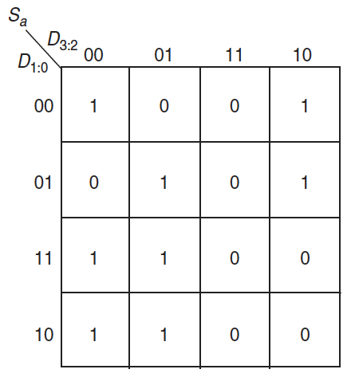
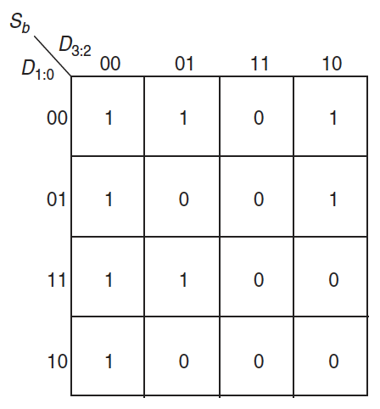
Seven-segment Display Decoder (2)
Each of the seven outputs is an independent function of four variables
As an example, we can draws K-maps for outputs S_{a} and S_{b}
Remember to label rows and columns in Gray code order: 00, 01, 11, 10

Slide 36
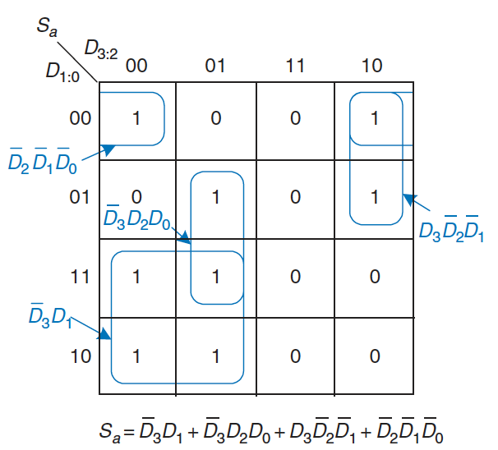
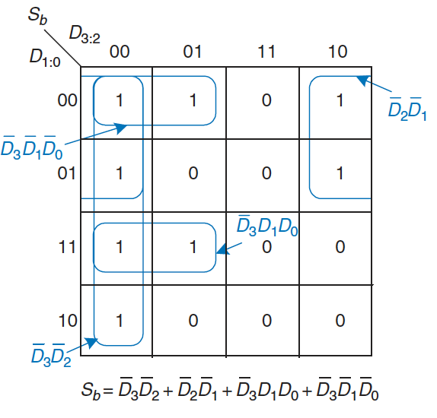
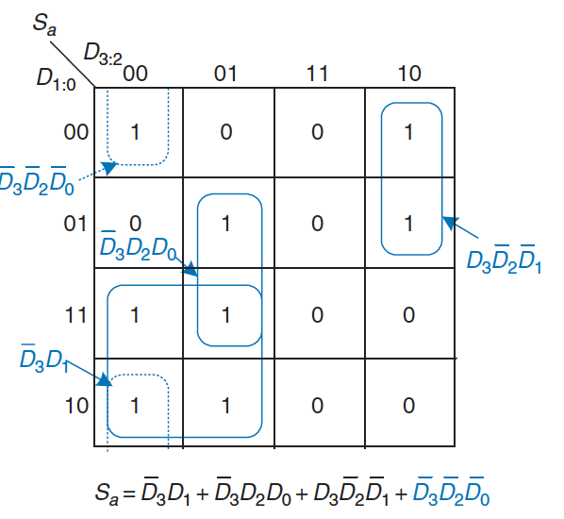
Seven-segment Display Decoder (3)
Circle the prime implicants:
Notice that the minimal set of prime implicants is not unique
For example
0000 entry in the S_{a} K-map was circled along with the 1000 entry to produce the D₂ D₁ D₀ minterm
the circle could have included the 0010 entry instead, producing a D₃ D₂ D₀ minterm

Slide 37
Don’t Cares (1)
Recall that “don’t care” entries for truth table inputs
can reduce the number of rows in the table when some variables do not affect the output
hey are indicated by the symbol X, which means that the entry can be either 0 or 1
Don’t cares also appear in truth table outputs where
the output value is unimportant
or the corresponding input combination can never happen
such outputs can be treated as either 0’s or 1’s at the designer’s discretion
In a K-map, X’s allow for even more logic minimization
they can be circled if they help cover the 1 with fewer or larger circles,
but they do not have to be circled if they are not helpful

Slide 38
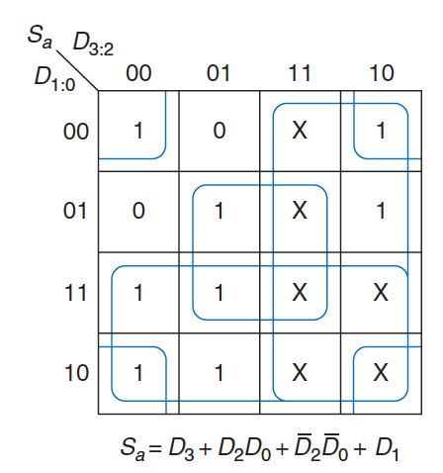
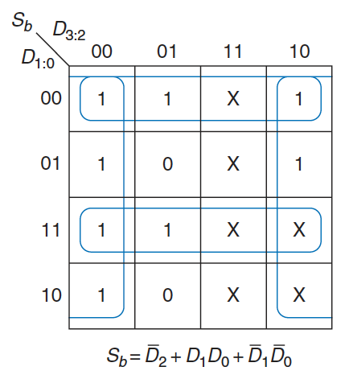
Don’t Cares (2)
We can review the seven-segment display decoder if we don’t care about the output values for illegal input values of 10 to 15
Because don’t cares can be 0 or 1, we circle a don’t care if it allows us to cover the 1 with fewer or bigger circles
Use of don’t cares simplifies the logic substantially

Slide 39
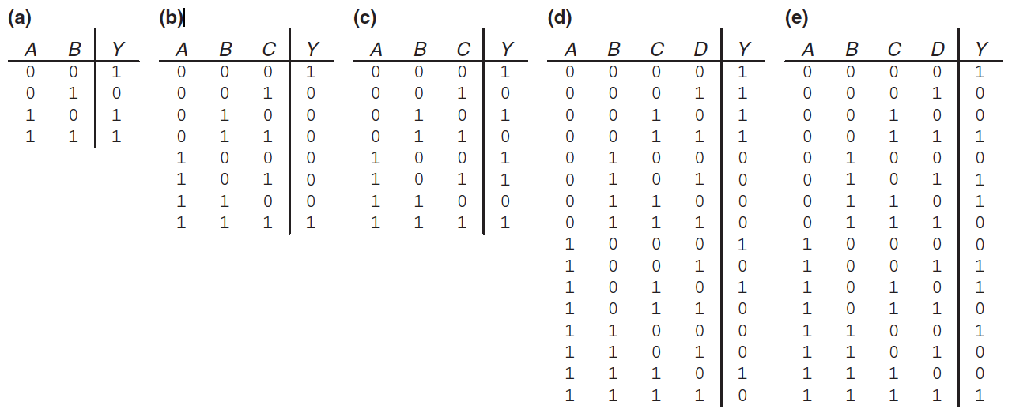
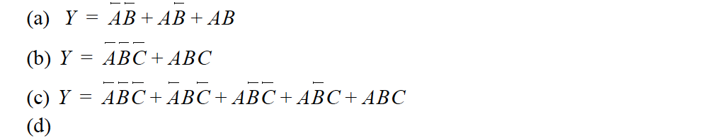

Exercises (1)
Ex5.1: Write a Boolean equation in sum-of-products canonical form for each of the truth tables
Solution:

Slide 40
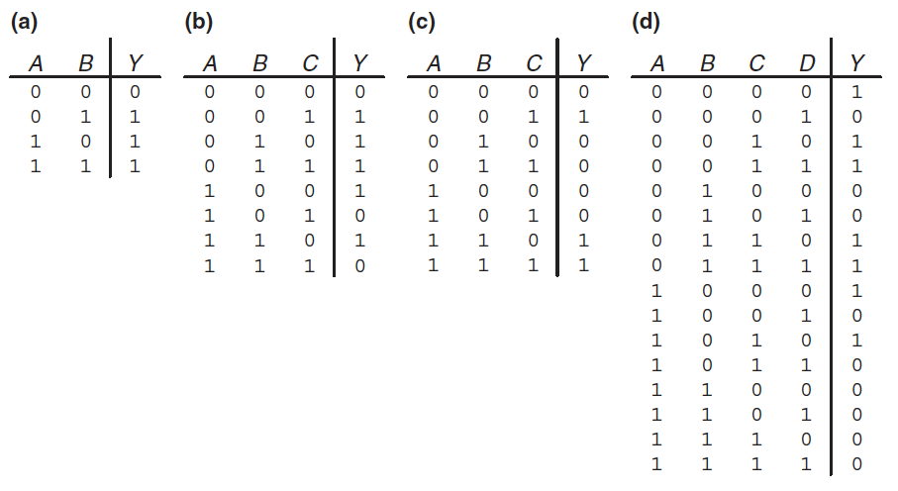
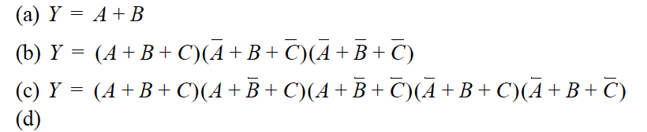
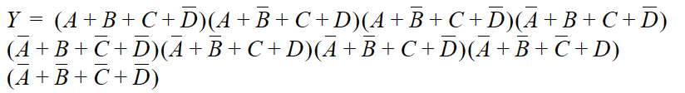
Exercises (2)
Ex5.2: Write a Boolean equation in product-of-sums canonical form for each of the truth tables
Solution:

Slide 41
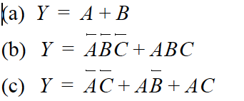

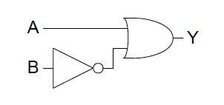





Exercises (3)
Ex5.3: Sketch a reasonably simple combinational circuit implementing each of the following functions. Reasonably simple means that you are not wasteful of gates, but you don’t waste vast amounts of time checking every possible implementation of the circuit either.
Solution:

Slide 42



Exercises (4)
Ex5.4: Find a minimal Boolean equation for the following true table and sketch the circuit
Solution:

Slide 43



Exercises (5)
Ex5.5: Find a minimal Boolean equation for the following true table and sketch the circuit
Solution:

Slide 44




Exercises (6)
Ex5.6: Complete the design of the seven-segment decoder segments S_{c} through S_{g} and sketch a reasonably simple gate-level implementation of part
Solution:

